Slide 1

SRI INDU COLLEGE OF ENGINEERING AND TECHNOLOGY DEPARTMENT OF AIML
III BTECH I SEM
BATCH : 9
SUBJECT: Computer Networks Laboratory
TOPIC: Dual-Protocol Chat Application Using TCP and UDP
TEAM MEMBERS:
S.Sirisha | 23D41A66G9
T.Harini | 23D41A66H0
T.Rishwanth | 23D41A66H1
U.Navya | 23D41A66H2
U.Akash | 23D41A66H3
batch 9

Slide 2
ABSTRACT
This project presents a GUI-based chat application that supports both TCP and UDP communication using Python. Traditional socket programs usually operate through the terminal, which can be confusing and difficult for beginners to visualize. To address this, the proposed system integrates Python’s socket programming with a graphical interface built using Tkinter.
The application allows users to select either TCP or UDP protocol and then exchange messages through a clean chat window. The GUI ensures clear message flow, easy usability, and real-time communication. This project effectively demonstrates how networking concepts can be implemented in a practical, interactive, and user-friendly manner.
batch 9

Slide 3
EXISTING SYSTEM
Uses terminal-based TCP/UDP programs
No GUI or clear message display
User must switch between multiple terminals
Hard to identify message flow
Not user-friendly for beginners
Limited to basic demonstration of sockets
batch 9

Slide 4
PROPOSED SYSTEM
GUI-based chat for both TCP and UDP
Clear chat window with labeled input field
Sends and receives messages in real time
Protocol selection at startup
More interactive and easy to use
Helps understand networking concepts visually
batch 9

Slide 5
HARDWARE AND SOFTWARE REQUIREMENTS
HARDWARE REQUIREMENTS:
Processor :- Intel Core i3 (1st Generation or above)
Hard Disk :- 256 GB
RAM :- 4GB
SOFTWARE REQUIREMENTS:
Operating System :- Windows /MAC OS
Programming Language :- Python
Libraries :- socket, tkinter, threading
Software used :- Visual Studio Code
batch 9

Slide 6
IMPLEMENTATION
server_tcp_backend.py
This file contains the TCP communication backend for the server.
Its responsibilities include:
Creating and configuring a TCP socket
Binding to the server’s host and port
Accepting a client connection
Receiving data sent by the client
Sending responses back
This file performs all low-level network operations, without any GUI components.
server_udp_backend.py
This file implements the UDP backend logic.
It performs:
Creating a UDP socket
Binding the server to a port
Waiting for incoming datagrams from clients
Sending messages back using the client’s address
Unlike TCP, this file handles connectionless communication, as UDP does not require a formal connection handshake.
batch 9

Slide 7
IMPLEMENTATION
server_gui.py
This file provides a graphical user interface for the server.
Key features:
Displays messages received from the client
Provides a text input box clearly labeled for sending replies
Buttons for sending messages and clearing the chat
Connects to either the TCP or UDP backend using function calls
It handles all user interaction, while the backend files manage networking.
client_gui.py
This file contains the client-side GUI used for chatting with the server.
It includes:
A main chat display area
A clearly marked message input box at the bottom
Send button for transmitting messages
Real-time updates of incoming server messages
The GUI communicates with the corresponding backend (TCP/UDP) functions to send and receive data.
batch 9

Slide 8
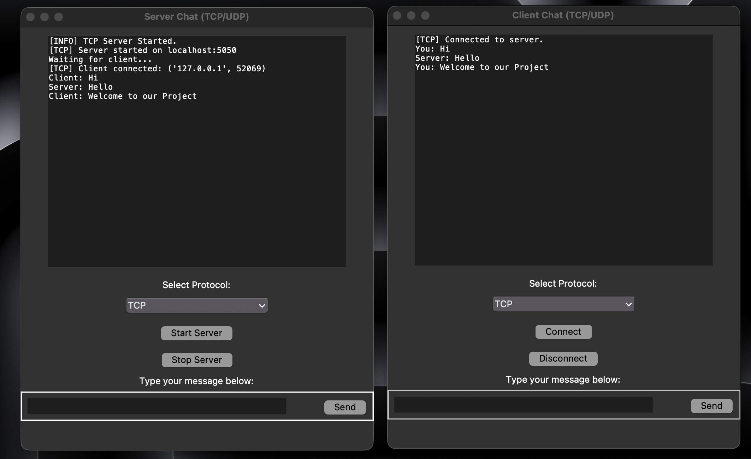
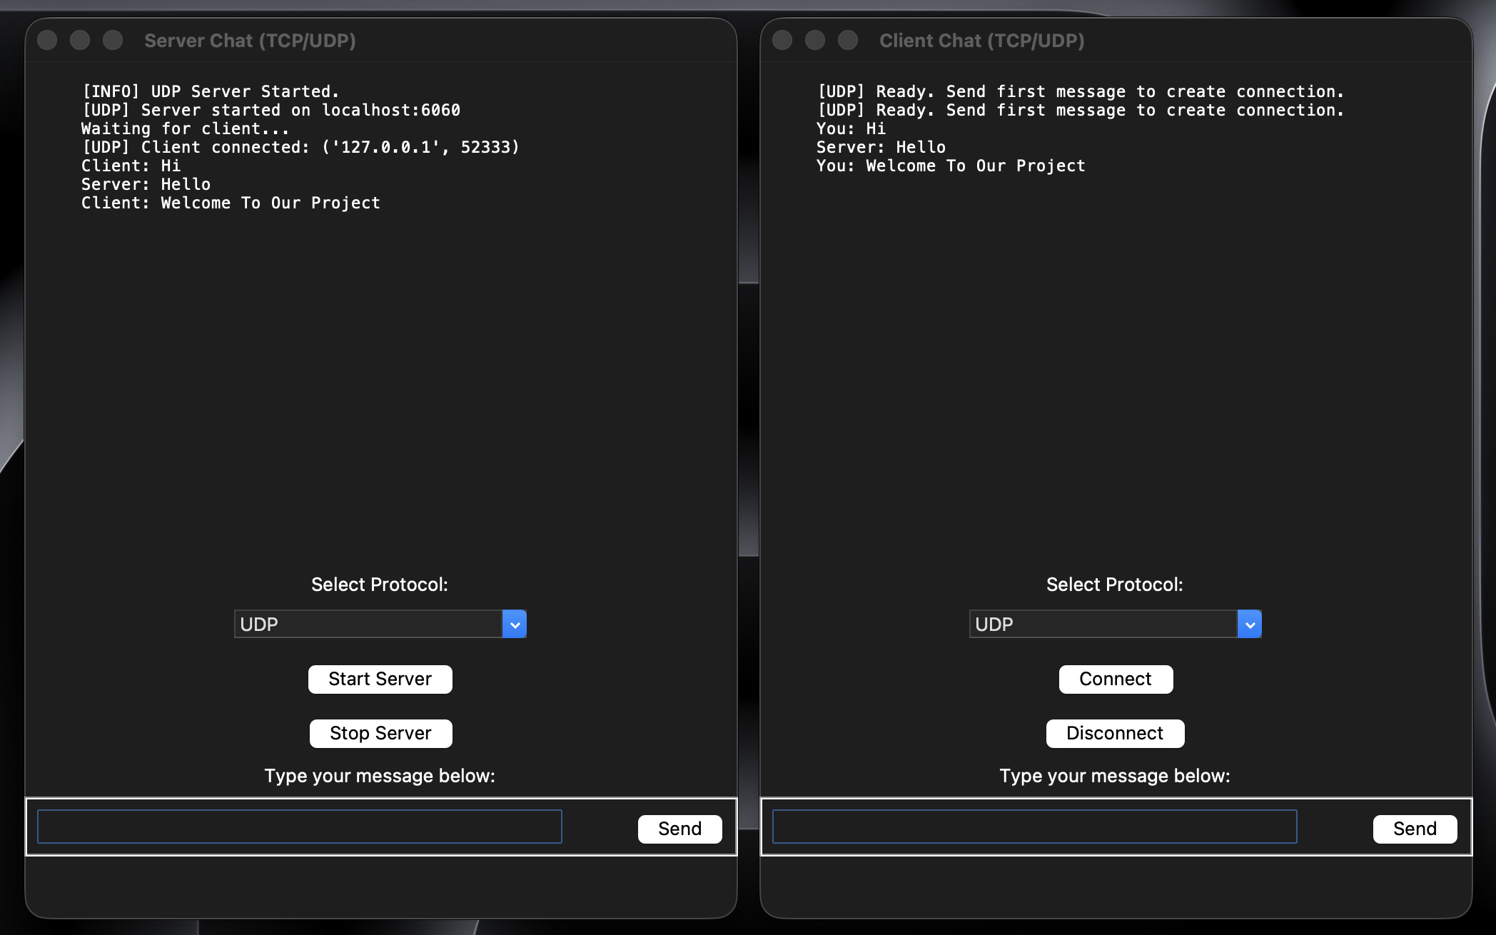
OUTPUT
batch 9

Slide 9
CONCLUSION
The GUI-based TCP/UDP Chat Application successfully bridges the gap between theoretical networking concepts and real-world implementation.
By combining socket programming with an intuitive graphical interface, the project transforms a simple terminal-based chat program into a fully interactive communication system. Users can clearly understand protocol behavior, message flow, and the differences between TCP and UDP in a hands-on manner.
The application is lightweight, easy to use, and enhances learning through visual interaction. Overall, the project demonstrates effective use of Python for building networking applications and provides a strong foundation for further enhancements such as encryption, file transfer, or multi-client chat systems.
batch 9

